Slide 2
Secure BIG-IP and Application deployments in AWS
August 2018
Justin Beckham, Ed Rabago, David Larsen

Slide 3
Cloud Formation Templates

Slide 4
Deploying Network and VPC

Slide 5
Deploying BIG-IP instance

Slide 6
Securing your BIG-IP instance
Change default passwords
Set AWS Filters for your management network
Set ciphers for you

Slide 7
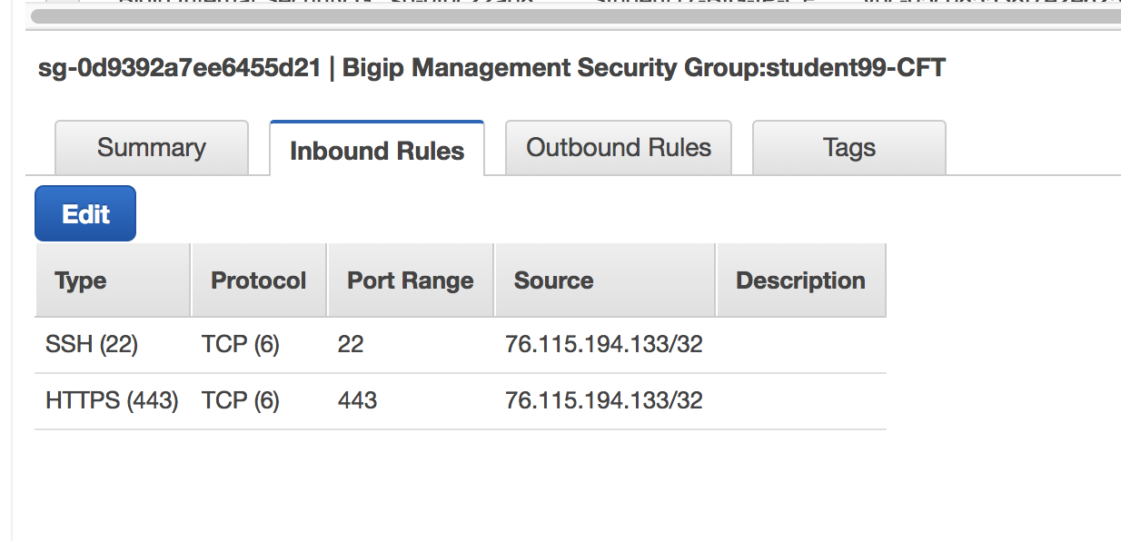
Inbound Security Group Rules in AWS

Slide 8
recommendations

Slide 9
9 Common Mistakes to Avoid in Your Presentation
On-premises, not on-premise. One is not the plural of the other—they are not interchangeable, but two completely different words. A premise is a proposition, whereas a premises is a tract of land.
BIG-IP. All caps, with hyphen. Not Big-IP, BIG IP, Big IP, or any other variation.
BIG-IP DNS. Not BIG-IP Global Traffic Manager or BIG-IP GTM.
BIG-IQ. All caps, with hyphen. Not Big-IQ, BIG IQ, Big IQ, or any other variation.
Silverline, cap S, lowercase l. Not SilverLine.
Data center, two words. Not datacenter.
No trademarks necessary. You do not need to include any trademarks in your presentations—please strip them all out.
Size matters. If the font size is too small for your audience to read, it’s worthless.
Don’t forget spell-check. It’s free, it’s fast, it can save you face.
You can find the complete F5 Content Style Guide here.

Slide 10
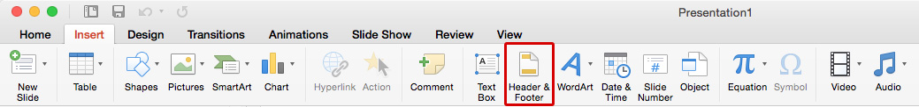
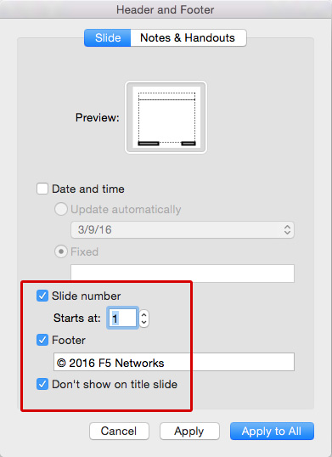
Turning on the Header & Footer
Go to the Insert tab, and click on Header & Footer.
You will get a pop-up box. Make sure the Slide tab is selected and not the Notes & Handouts tab.
Make sure to the Slide number, Footer, and Don’t show on title slide boxes are all checked.
Select Apply to All *Note if you choose Apply it will only apply to that single slide.

